Slide 1
ENGINEERING CLINICS
AUTHENTICATION OF NUMBER PLATES

Slide 2
PROBLEM STATEMENT
Students in our college feel comfortable to park their vehicles inside our college. Some students who haven’t registered too, park their vehicles. Our college security system finds it difficult to check whether the vehicle is registered or not. This project aims to reduce the burden of our college security.

Slide 3
Introduction
Data for this project is taken through Image processing method.
We took videos of vehicles entering our college and noted their in and out time.
The registration numbers are recognised from number plates of vehicles using MATLAB.
And it is cross checked with our college database to find whether it is registered and classified them as ‘Students’ and ‘Staffs’.

Slide 4
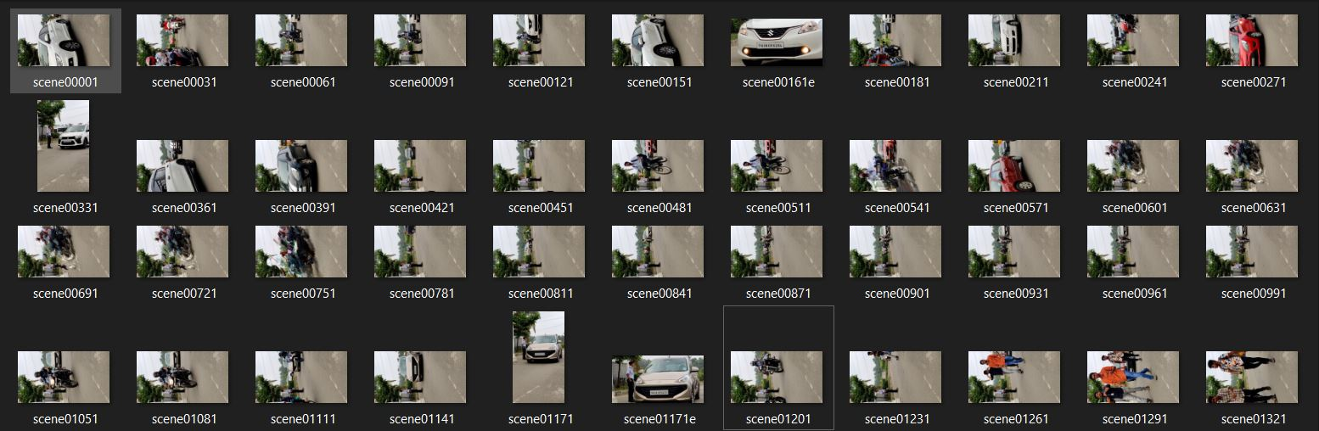
Screenshots of vehicles

Slide 5
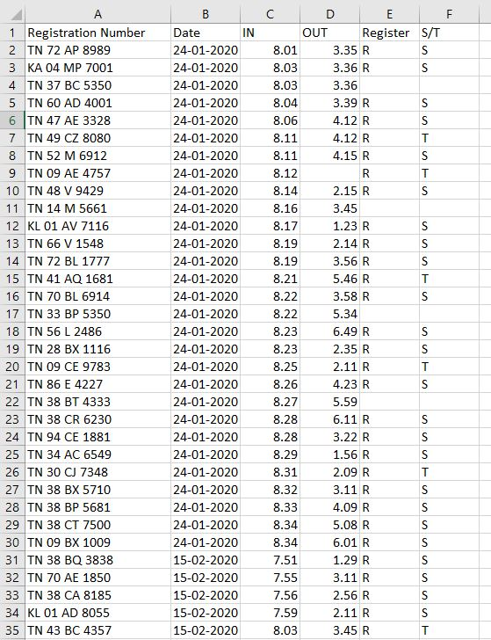
Dataset(before preprocessing)

Slide 6
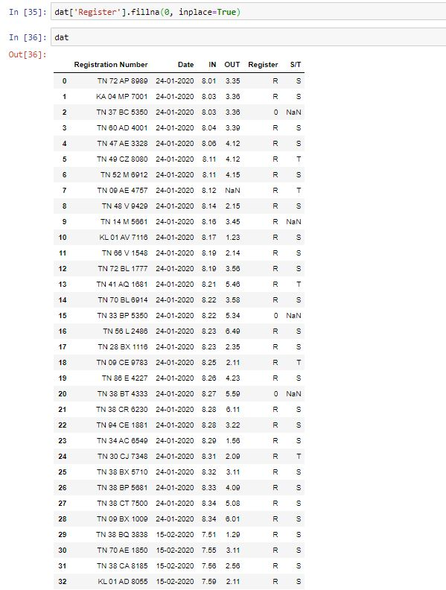
Filling missing value Techniques
1: Filling with Zeros

Slide 7
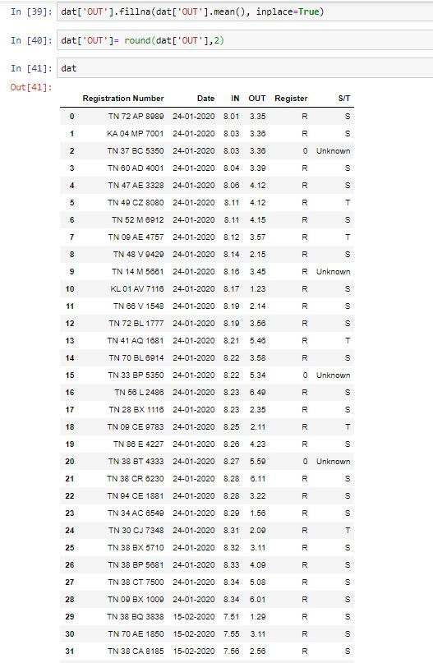
2.Filling with Mean

Slide 8
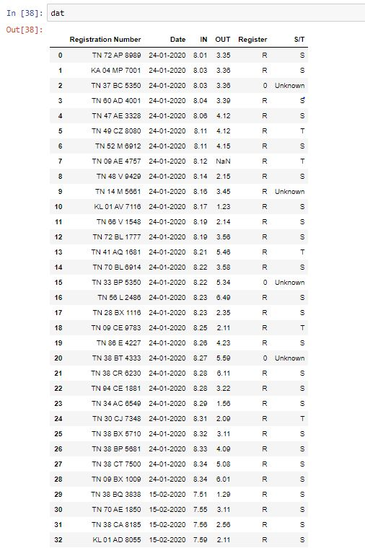
3.Filling with custom Values

Slide 9
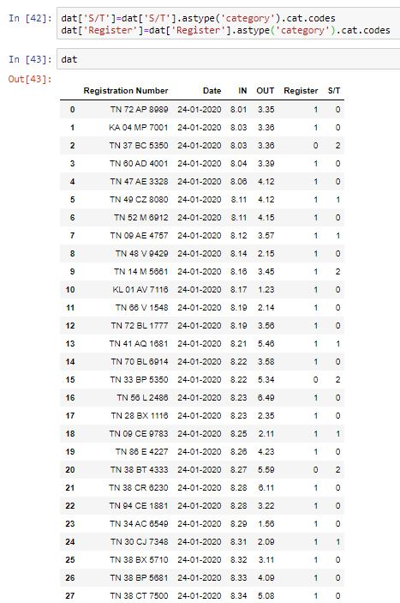
Converting object to categorical variable

Slide 10
Analysing individual Fields
1.Registration number : The registration number of the vehicle which is obtained by image processing.
2.Date : Date of the entry of the vehicle.
3.IN : In time of the vehicle.
4. Out : Out time of the vehicle.
5.Register : Shows whether the vehicle is registered or not
6.S/T : Whether the vehicle is registered under the name of a student or staff.

Slide 11
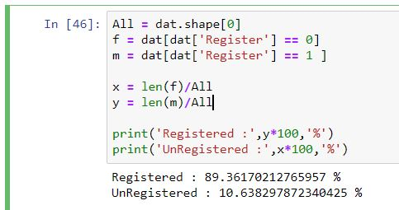
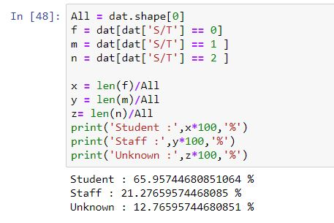
Analysing the categorical columns
1. Register column:
2. S/T:

Slide 12
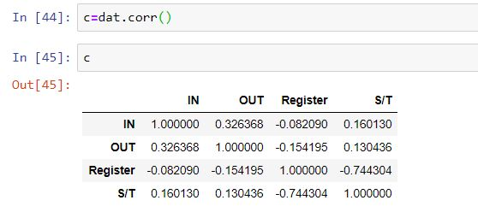
Correlation btw each field

Slide 13
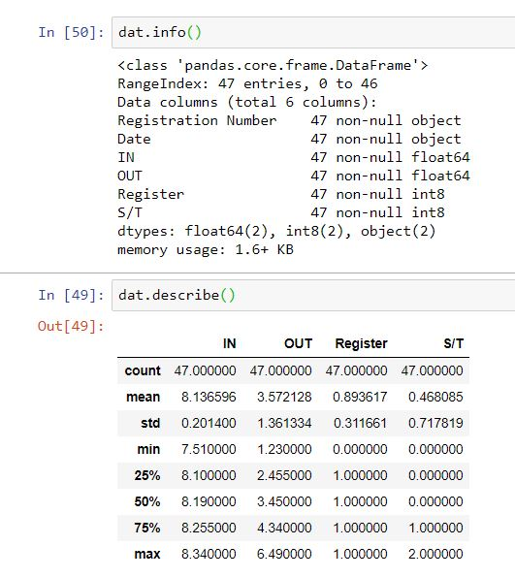
Information extracted

Slide 14
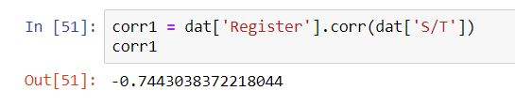
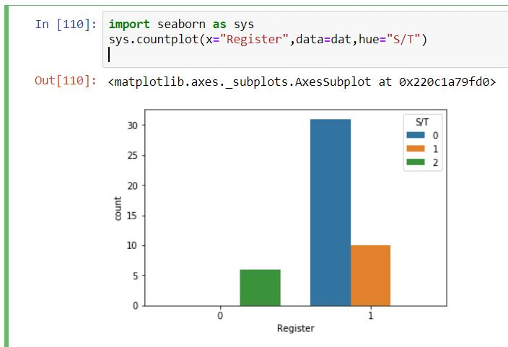
Correlation btw ‘Register’ and ‘Student’:
It is a negative correlation.
The value of ‘Register’ is highly in negative correlation with respect to ‘S/T’.

Slide 15
REFERENCES
Research paper : http://ijcsit.com/docs/Volume%202/vol2issue3/ijcsit2011020360.pdf
Website : https://towardsdatascience.com/working-with-missing-data-in-machine-learning-9c0a430df4ce
Online Course : https://swayam.gov.in/nd1_noc19_cs58/preview

Slide 16
Data Transformation Techniques For the Image
1.Grayscaling the Image.
2.Binarizing the Image.
3.Edge Detection For the Image.
4.Smoothing- Noice From the images are reduced.
5.OCR – Extracting the characters from the Image.

Slide 17
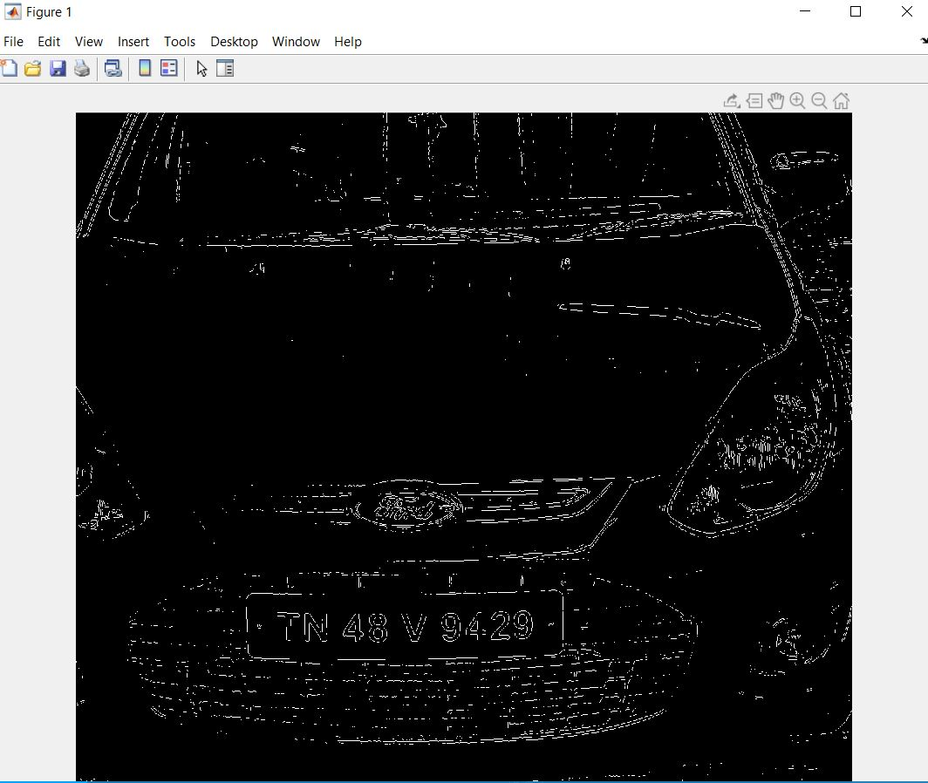
GRAY SCALE IMAGE

Slide 18
